Slide 1

COVID – 19 REPORT MANAGEMENT SYSTEM
Using PHP and MySQL
November 2021

Slide 2
DEPARTMENT OF COMPUTER SCIENCE PSG COLLEGE OF ARTS AND SCIENCE MINI PROJECT COVID-19 REPORT MANAGEMENT SYSTEM
DONE BY : KARTHIKEYAN.S REG.NO: 20MCM015
GUIDE : PROF. T.KOUSIGA

Slide 3
ABSTRACT
Nowadays, COVID19 Report Management System is one of the most essential tools that are mostly used in Testing Lab; it is mostly used to manage COVID19 medical lab related activities. In this project we tried to develop a computerized and web based COVID19 report management system.
Our main intention is to allow this application to be used in most retailing COVID19 lab, where a small point of customization will be required to each COVID19 lab in the implementation period. This system is designed to overcome all challenges related to the management of diagnostic that were used to be handled locally and manually.
The system is an online COVID19 lab manager application that brings up various COVID19 test working online. Using this system, it will help us to records all transaction made at the daily tests; recognize all customers, employees, etc. It will manage all activities around the COVID19 lab that increases productivity and maximize profit, it will also minimizing the risk of getting loss because all transactions are recorded to the system.

Slide 4
INTRODUCTION
COVID19 Report Management System is web based technology which brings up various diagnosis works online.
Here patients are first allowed to register on the website and provide personal, test information.
Once registered with their address and contact details, the patients may now see a variety of tests conducted by the lab. The patient will select the required test and book appointment after that lab center send a lab staff at registered address to collect a sample.
After successful sample collection patient can track their test history using the name, order and registered mobile number. The system allows admin to attach a copy of the report into the system and automatically shown on user side so user can downloads report.

Slide 5
SYSTEM SPECIFICATION
HARDWARE SPECIFICATION
SOFTWARE SPECIFICATION
PROCESSOR | AMD PRO A4-3350B APU with Radeon R4 Graphics 2.00 GHz
RAM | 4GB-RAM
HARDDISK DRIVE | 500GB
SSD | 240GB ( OS )
OPERATING SYSTEM | Windows 10 Pro – X64
FRONT – END | PHP 6 , HTML 5 , CSS , JS
SERVER | WAMP APACHE
BACK - END | MySQL

Slide 6

MODULE DESCRIPTION
In COVID19 Report Management System we use PHP and MySQL database. It has two modules i.e.
1 . ADMIN
2 . USER (Patient)

Slide 7
ADMIN Module
Admin is the super user of the website who can manage everything on the website. Admin can log in through the login page
Dashboard: In this section, the admin can see all detail in brief like the total, assigned and the sample collected and completed tests.
Testing: In this section, the admin can manage all the tests like assign the test to Phlebotomist and update the history.
Report: In this section, the admin can generate two types of report. One is between dates reports and another one is by search. Admin can search the report by order number, name and mobile number.
Notification: In this section, the admin will get a notification for every new test request (notification bell).

Slide 8
USER Module
Testing: This section divided into two parts. One is for new user and another one is for registered user. New user (First-time user) needs to provide personal and testing Information. A registered user only needs to provide test information; their personal information will be fetched from the database.
Report: In this section, Users can search their test report using order number, name and registered mobile number.
Dashboard: In this section, the User can see the in which State of how many tests are done.

Slide 9
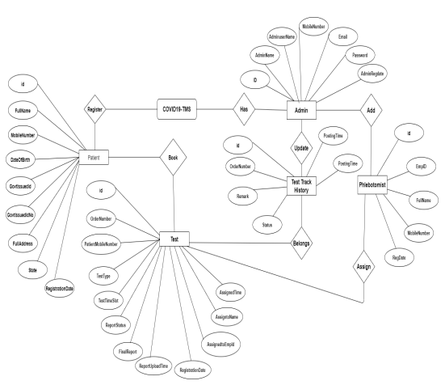
ER DIAGRAM

Slide 10
PURPOSE
The main purpose of COVID19 Testing management system to provide a platform where patients can book the test online and get their COVID19 test done at home.
With the help of this project we are bringing the use of technology in the field of medical diagnosis where patients can avail all the diagnosis facilities at their door steps.
Another purpose for developing this application is to generate the report automatically

Slide 11
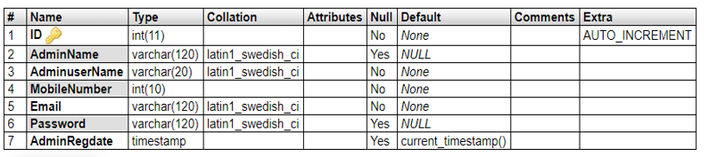
MySQL DATA TABLES
Admin Table:(Table name is tbladmin)
This store admin personal and login details.

Slide 12
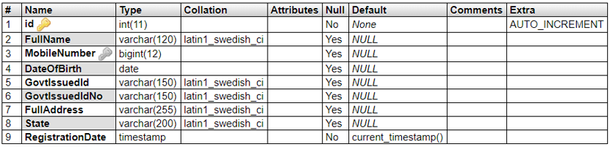
tblpatients
This table store the data of patient personal Information.

Slide 13
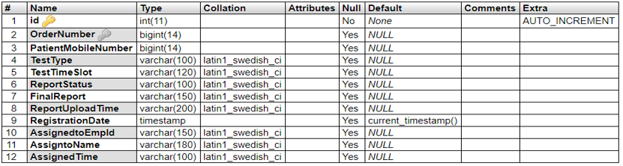
tbltestrecord
This table stores the patient test record details.

Slide 14
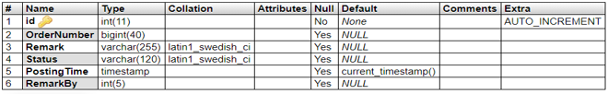
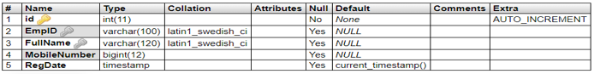
tblreporttracking
This table stores the tracking details of tests.
tblphlebotomist
This table stores the phlebotomist information.

Slide 15
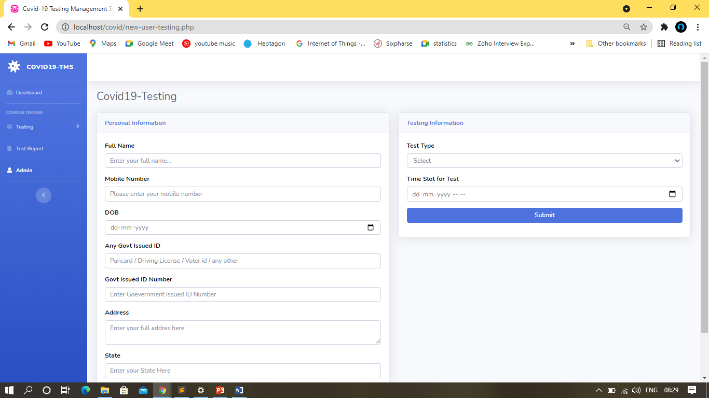
INPUT & OUTPUT SCREEN
New User (Patient) Test Booking

Slide 16
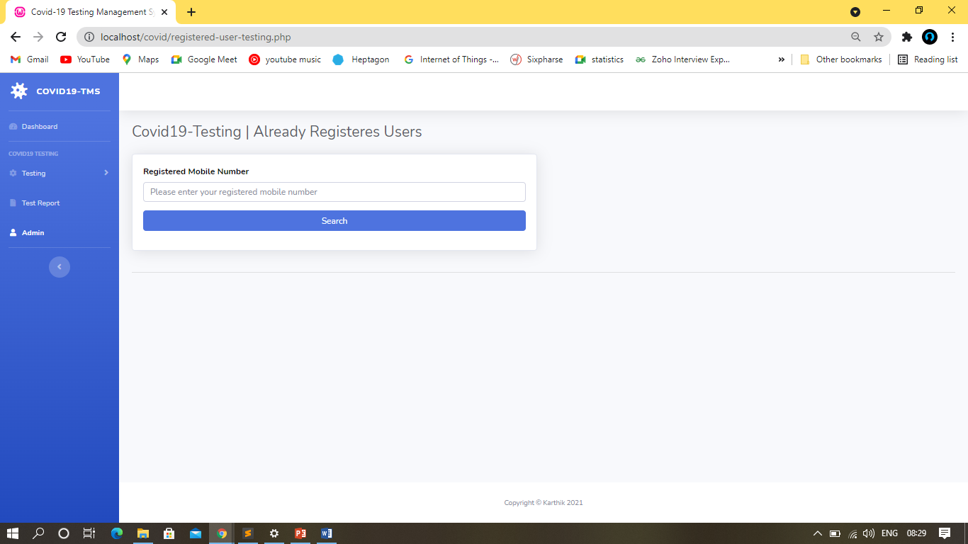
Already Registered User (Patient) Test Booking

Slide 17
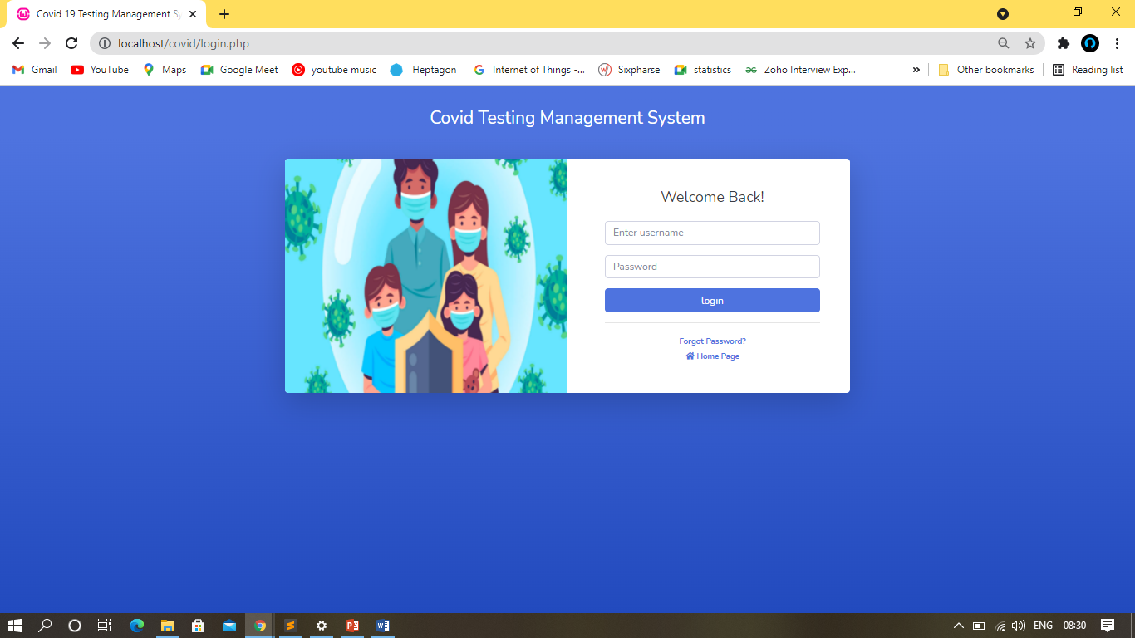
Admin Login

Slide 18
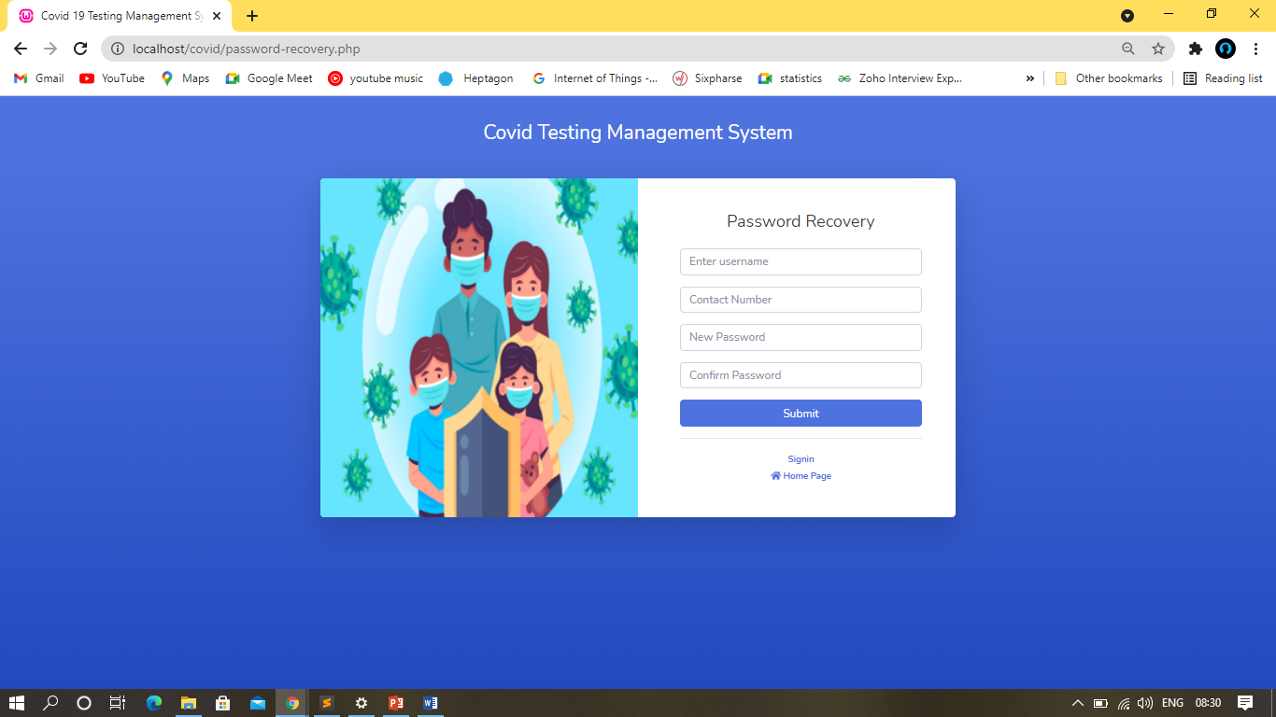
Admin password recovery

Slide 19
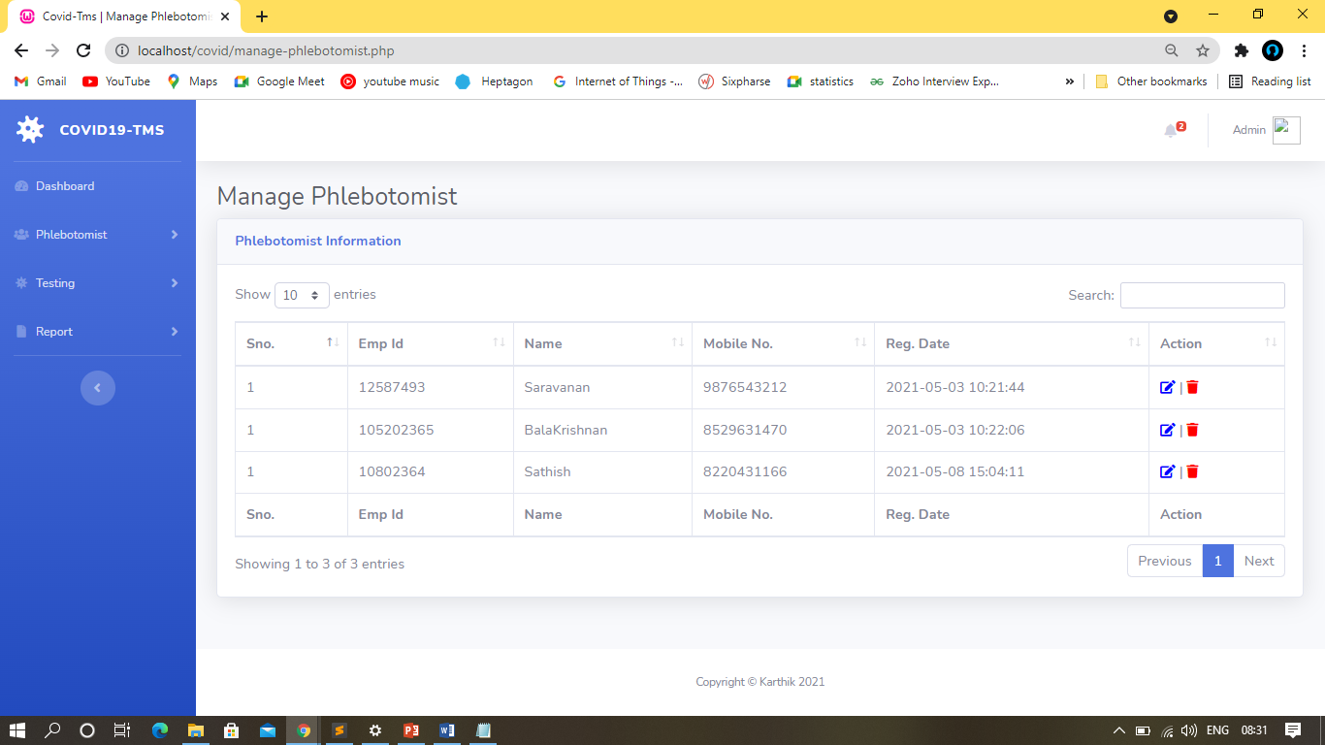
Manage Microbiologist

Slide 20
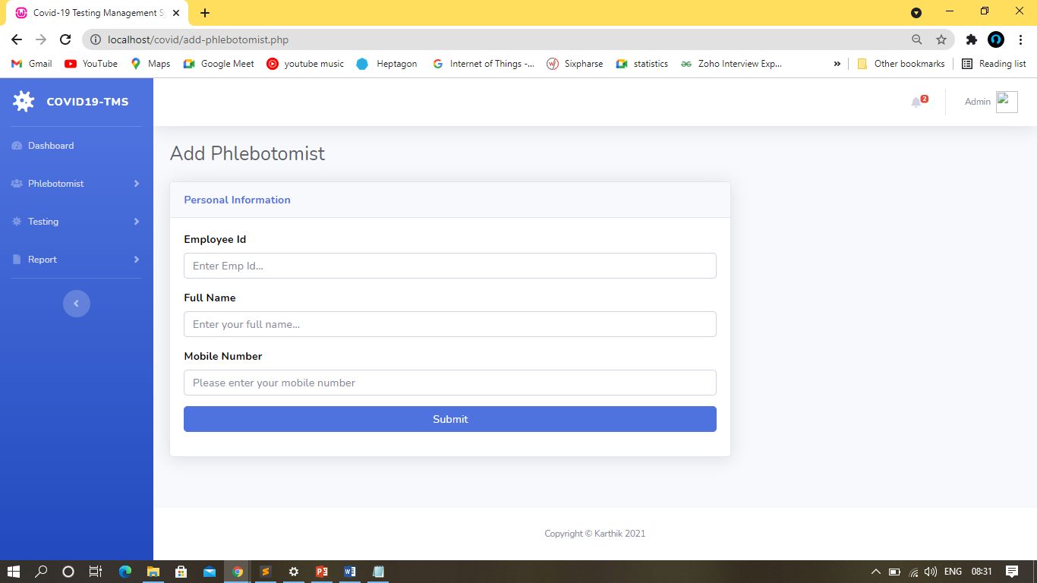
Add Microbiologist

Slide 21
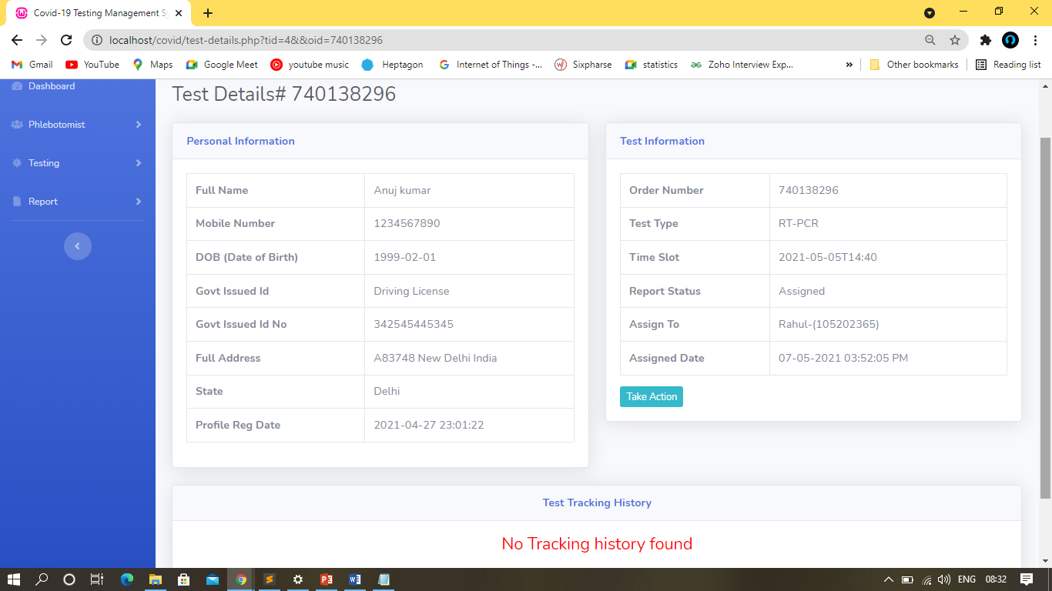
Test details

Slide 22
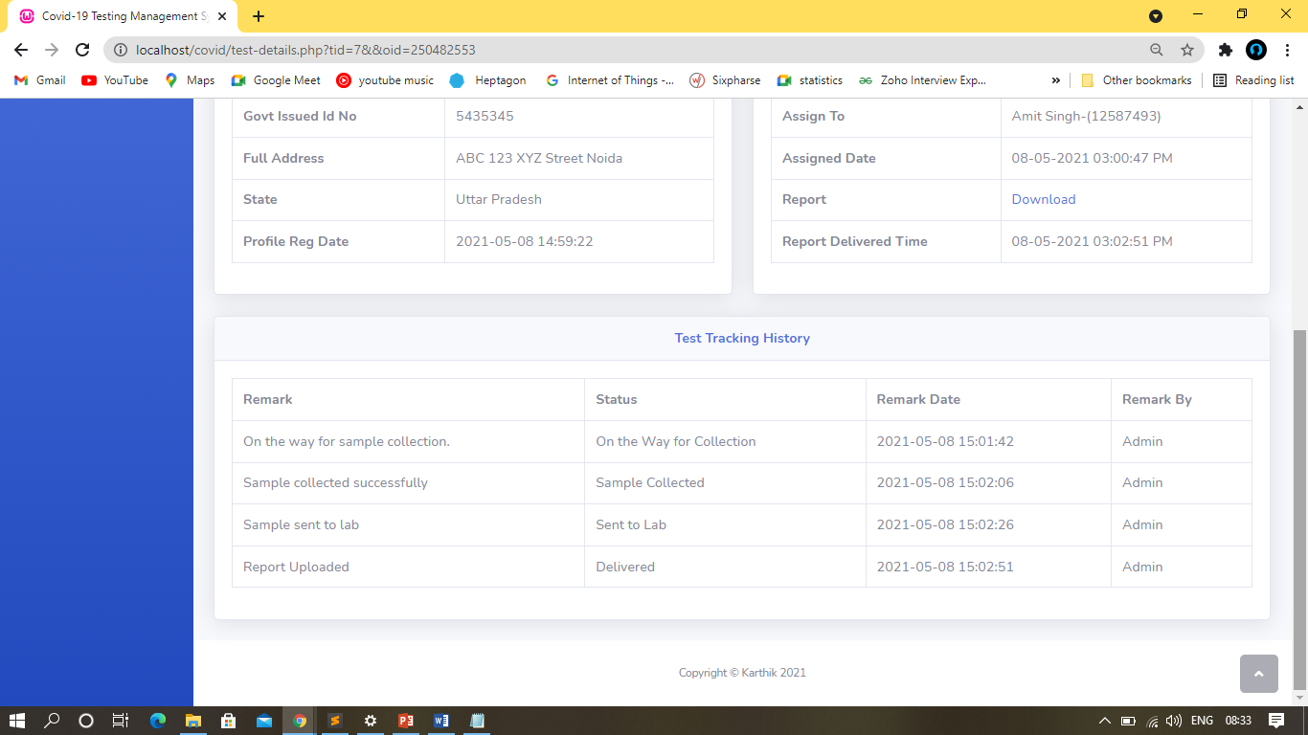
Report generate & Tracking

Slide 23
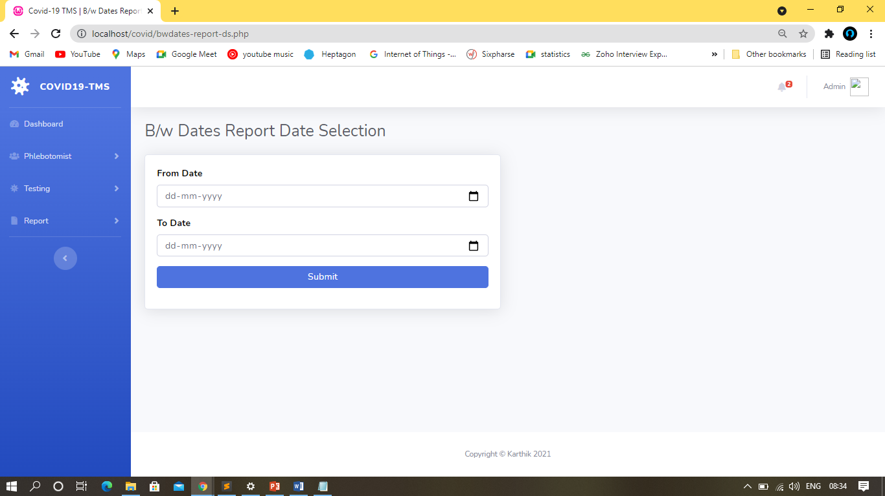
Search Report in Date wise

Slide 24
THANK YOU!

